Slide 1
Using OneNote for student e-portfolios
Angelica Risquez, Centre for Transformative Learning

Slide 2
Overview
Overview of the application and the features
Some ideas for using One Note*
* Adapted from a blog by Tom Grissom: https://educationblog.microsoft.com/2017/03/10-best-uses-for-onenote-in-your-teaching-and-learning/#wshqKFaeI3sJp2Hr.99
Notes:
OneNote is a free form tool, so I’m not sure if it is helpful to describe a its application in one context, with one example.
So I have decided to show you some features for you to consider, and maybe adapt for your own context.
Then, if you are willing to share your experience, we can showcase it as part of the next OneNote workshop.

Slide 3
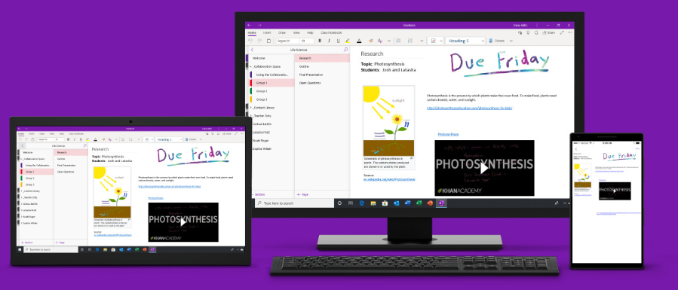
Why use One Note for collaborative e-portfolios
Integrated with Sulis - safety
All team members can edit
Multimedia (audio/video, links, etc)
Embed video/spreadsheets/documents/

Slide 4
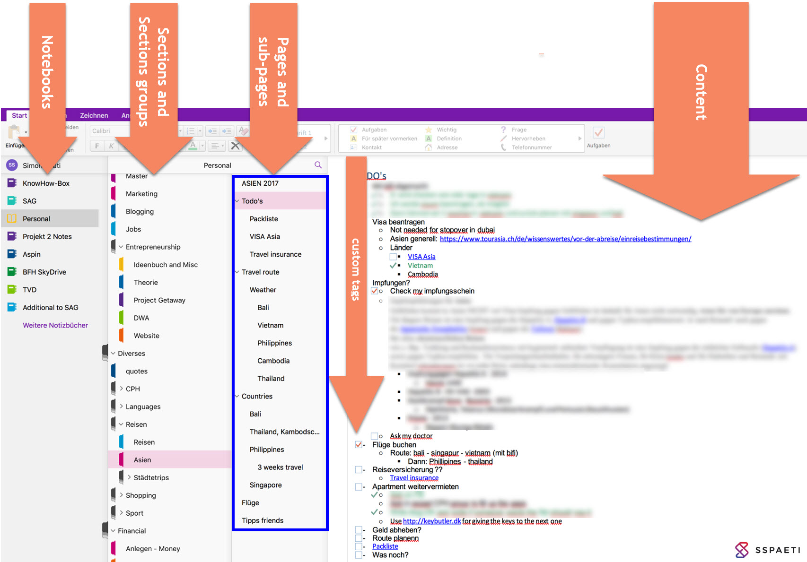
1. Organising
Notes:
Notebooks are similar to a Ring binder, Sections are similar to the tabbed pages in the ringbinder, pages and sub pages, well, this is the content, in small groups (stapled together!)
You can organize digital notebooks by Sections and Pages in a way that makes sense to you….. By week, by topic, by chapter

Slide 5
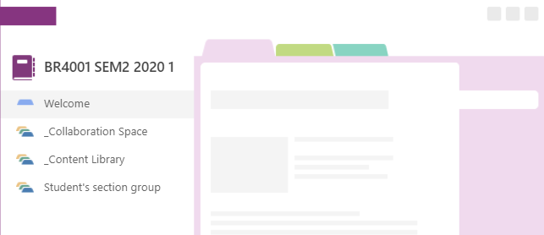
Section groups of your class OneNote notebook
Notes:
The Collaboration space is where you will build the e-portofolios for your campaign.

Slide 6
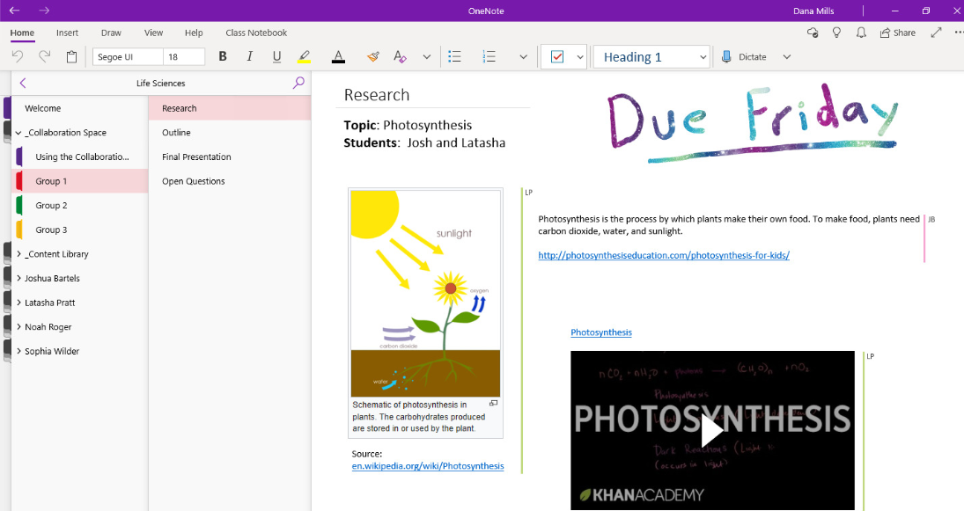
Collaboration Space
Notes:
The Collaboration Space acts like a whiteboard where each group member can edit and add content.

Slide 7
Access from Sulis

Slide 8
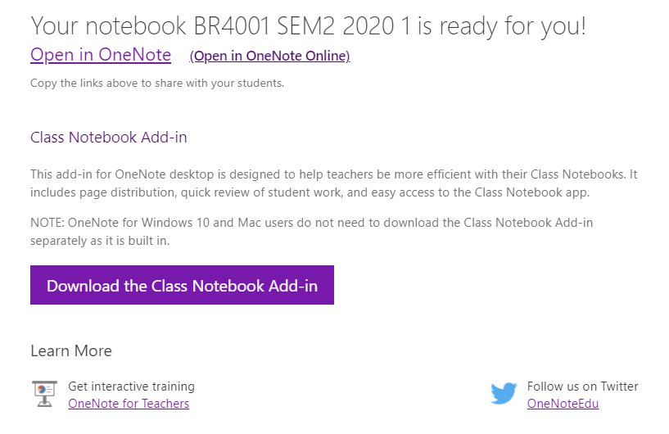

Slide 9
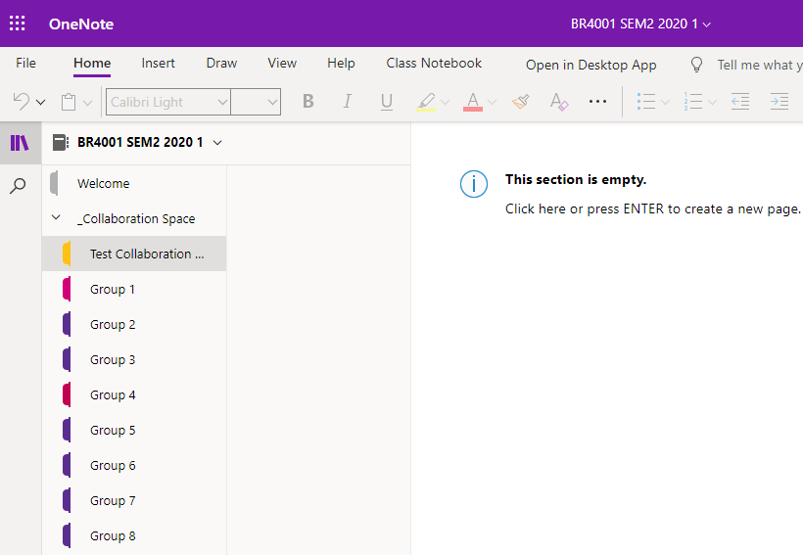
Getting started
Create pages
Add content, images, videos, links and much more
You all have access to the Test Collaboration Space to play with the tool
Only team members have access to each group
Your teacher will see who has contributed material to your groups space (each contribution is marked with the name of the author for the teacher)

Slide 10
Questions
Notes:
I didn’t want to go through every single feature on OneNote, there are quite a few, but this presentation was just to give you a flavour of some of the ways in which it can be used.
So you can go away, and think about how it might be useful to you, or if you want to discuss a way in which we can explore it further here, please feel free to ask the question.

